Slide 1
William Paterson University Policy and Procedure for Effort Reporting
Office of Sponsored Programs
January 2014

Slide 2
New Policy Effective January 1, 2014
Effort Reporting Form can be submitted for retrospective reporting for Spring and Summer 2013 if a report has not already been submitted
Policy, Effort Reporting Form and support materials are on the OSP Webpage:
http://www.wpunj.edu/osp/managing-awards.dot

Slide 3
Substantial Differences
Old Policy and System
New Policy and System
Driven by employee
2-form system required supervisor signatures
Submission of paper form to the OSP
Forms required daily tracking
Information manually entered into database by OSP staff
Policy too broad and incomplete in many ways, did not include consequences
Reminder sent by OSP
1-form system does not require supervisor signature
Form submitted electronically to OSP
Once-a-semester estimate
Electronically uploaded into database by OSP staff
Policy provides clear definitions, process and consequences

Slide 4
Policy Statement
William Paterson University will establish and maintain an effort certification system in accordance with the provisions of OMB Circular A-21 (2 CFR Part 220).
OMB Circular A-21: Cost Principles for Educational Institutions
Establishes foundation regulation that all Federal funding agencies must base their regulations upon
Used by State of New Jersey for both its own funding and for Federal pass-through funding
This “plan-confirmation” system meets requirements

Slide 5
The effort certification system will provide assurance to sponsors that (1) salaries charged to sponsored projects or provided as a cost-shared expense are reasonable in relation to the work performed, and (2) that faculty and staff have met the commitment of effort that is defined within an award contract.
Proposal established effort and expense expectations that was accepted and became part of the contract
Effort report documents that the expectation was realized during the implementation of project
Cost of effort appropriate and consistent for WP

Slide 6
The effort certification report will verify that personnel costs charged to a sponsored project or provided as committed cost sharing for a sponsored project are reasonable, allocable, consistently treated, and allowable under the specific sponsored agreement.
Reasonable: time appropriate for the job
Allocable: work was done for the project
Consistently treated: follows WP policies & processes
Allowable: can be paid by the award and is within the terms of the award and sponsor regulations

Slide 7
Covered Employees
“Covered Employees are … full-time faculty, professional and administrative staff engaged in a sponsored project.”
Effort is within an employee’s regular duties
Cannot include overload or overtime, fund raising, unrelated committees
Additional compensation only for activity (a) across departmental lines, (b) in addition to regular duties, (c) work is short term, and (d) approved by sponsor
10-month employees: (a) compensation for work in summer will not exceed 1/10th of salary, and (b) compensation for teaching courses will not exceed WP’s standard rate

Slide 8
Regular Duties are those activities that the employee was hired to perform, including any additional duties that have been added or assumed, for which they are compensated through their salary, including holiday, vacation and sick time. This is the 100% effort.
Institutional Base Salary (IBS) is the salary or wages received for an employee’s regular duties. This is the value of the 100% effort.
“IBS does not include work done as overload (for faculty and professional staff), overtime (for professional and administrative staff), adjunct assignment, presenting or attending a workshop, and compensation for other incidental activities because such work and compensation are separately identified and are separately documented in Banner Finance.”

Slide 9
Table 1: IBS Components for Faculty, Professional and Administrative Staff
 | Faculty IBS Academic Year and other 10-Month Employees (September to June) | Professional Staff (12 months, July to June) | Administrative Staff (12 months, July to June)
Activity to be compensated within the IBS | -Teaching, research/ scholarship, service, and administration -Sponsored Project Effort Commitment -Release time provided for research, service or administration | -Administrative responsibilities -Academic responsibilities -Sponsored Project Effort Commitment | -Administrative responsibilities -Sponsored Project Effort Commitment
Activity NOT included within the IBS | -Overload -Overtime -Workshops and incidental activity -Summer Salary | -Overload -Overtime -Workshops and incidental activity -Adjunct assignment | -Overload -Overtime -Workshops and incidental activity -Short-term support -Adjunct assignment

Slide 10
Non-Covered Employees
Non-Covered Employees are part-time faculty, administrative staff, research support staff, under-graduate or graduate student assistants who are engaged in a sponsored project.
The limited and exclusive nature of their duties allows for use of the “Part Time Employee Timesheet” or the Additional Compensation Memo to be sufficient documentation of effort to the project.
The timesheet or memo cannot represent effort provided to more than one project because the FOAPs will be different. Planned re-allocation is not allowed.

Slide 11
PI/PD Responsibilities
Certifies all effort provided by project staff
Retains all PCFs, HRAFs, FLMs, part-time timesheets, Employee Effort Certification Reporting Forms, Effort Summary Certification Forms and Additional Compensation Memos for at least 7 years following the end date of the award
Determines whether the annualized level or effort will meet goal or if effort in contract must be adjusted
Obtains Employee Effort Certification Reporting Form from staff if they leave the project before the end of a reporting period

Slide 12
Employee Responsibilities
To submit their “Employee Effort Certification Reporting Form” promptly after receiving email notification from the OSP
Keep a copy of each Reporting Form he/she submits
Maintain a diary, calendar, report or other record of their activities to support their Reporting Form
If an employee leaves a sponsored project before the end of a reporting period, she/he must provide an Reporting Form before their affiliation ends

Slide 13
Consequences for Failing to Certify Effort
For WP:
Failure to receive Effort Certification reports could:
In the event of an audit finding, result in WP paying back funds to sponsor along with fines and penalties and trigger additional audits
Jeopardize all of WP’s Federal and State awards, including student aid
For Employee:
Disciplinary actions include no new grant-related activities, such as proposal submission, project start-up, involvement in projects, and award-related tasks
Correction will include submission of report(s) and may include attending training or other activities

Slide 14
The Process
Online Tutorial
Summarizes previous slides
Detail attention to following slides

Slide 15
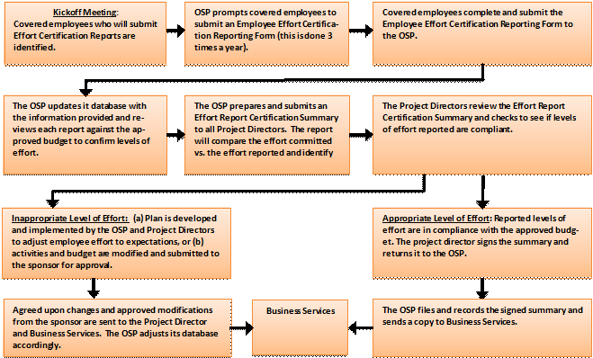
Table 2: Effort Reporting Flowchart

Slide 16
Covered Employee
OSP Effort Certification Notice email sent January 1, June 1 and September 1
Reports due January 15, June 15 and September 15

Slide 17
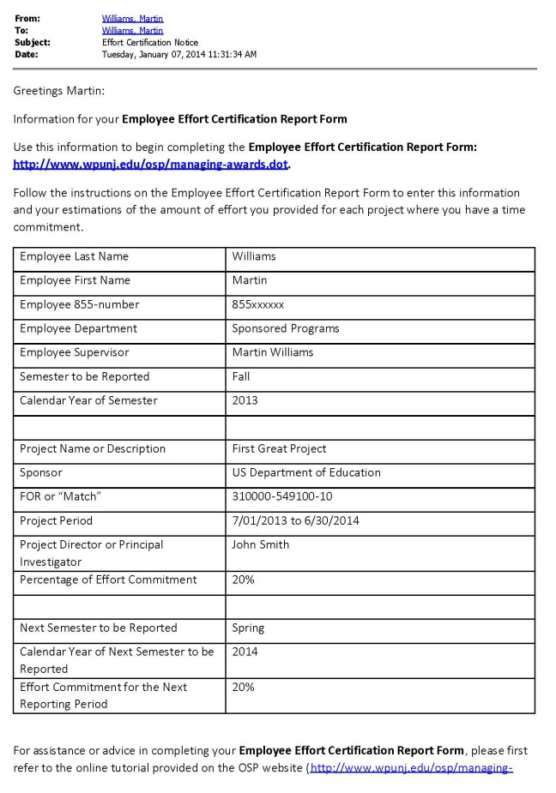
Effort Certification Notice email
Provides information on:
the covered employee
the period to be reported
the sponsored project
the next reporting period
This information to enable completion of the Employee Effort Certification Reporting Form
If information is wrong, correct it on the Reporting Form, make changes here and return it to the OSP

Slide 18
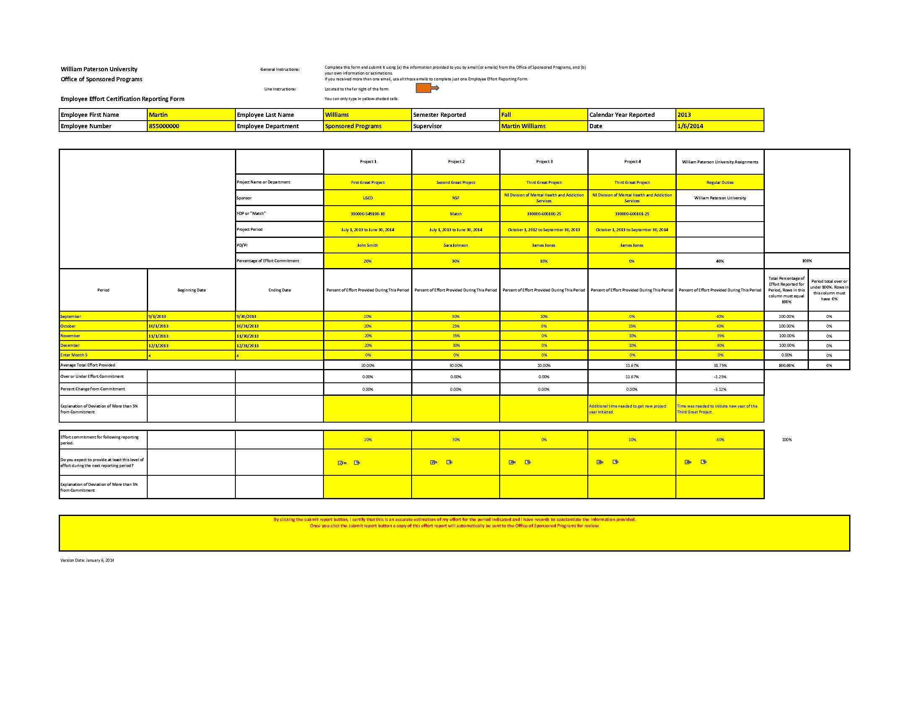
Employee Effort Certification Reporting Form
** click here to open form **

Slide 19
➔ Line by line instructions are located to the right, outside the print area
⬆ Employee’s information is entered along top
⬅ Project-specific information is entered in next section
⬅ Estimate of effort entered for each month of reporting period. If lines aren’t needed, leave unchanged.
⬅ Respond to question if amount of effort is different from the required commitment.
⬅ Enter expected level of effort for the next reporting period and then answer questions.

Slide 20
➔ Enter details and effort for other projects as provided in other emails; balance of effort assigned to Regular Duties
➔ Effort cannot exceed 100%. This automatic calculator tracks totals to help refine and adjust levels of effort.
To Submit
Save to your computer
Print a copy for your files
Click submit to certify and email report to the OSP
SUBMIT

Slide 21
PI/PD
OSP generates report for review by project directors
If review shows problems
with levels of effort, then
plan developed to fix or
modification submitted

Slide 22
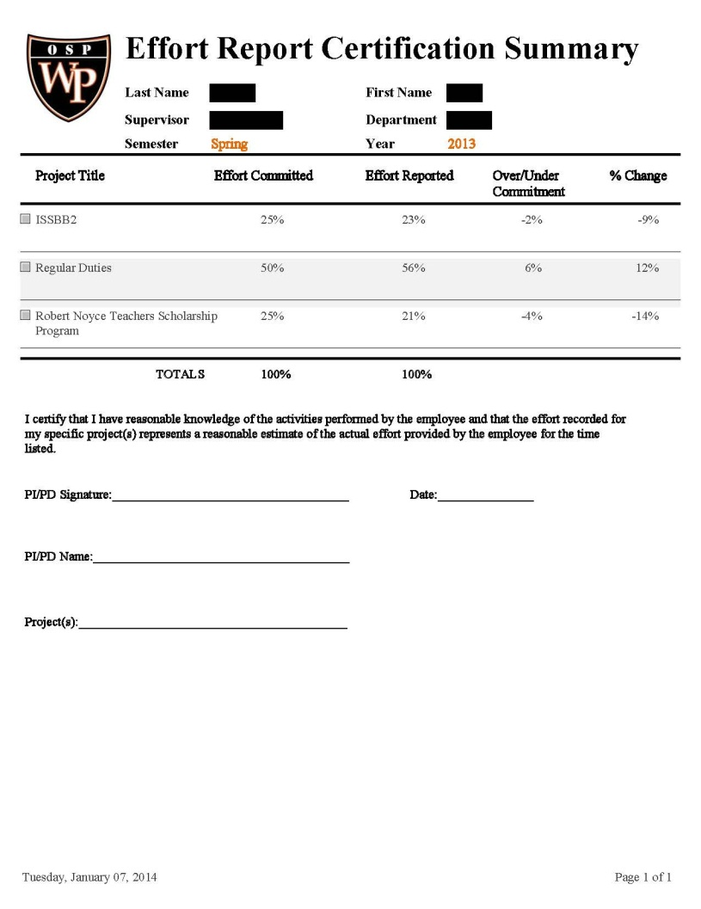
OSP generates reports for PI/PDs for each covered employee
PI/PD reviews Employee Effort Certification Reporting Forms and Effort Certification Summaries, then signs Summaries if acceptable
Copies of summaries are provided to Business Services
If modification are needed, process is begun with support of OSP

Slide 23
Contact Information
Martin Williams
Director, Office of Sponsored Programs
Raubinger Hall, Room 309
williamsm@wpunj.edu
973-720-2852
Effort Reporting Forms and Resources:
http://www.wpunj.edu/osp/managing-awards.dot

